Slide 1
CTE 2059 - Computer Graphic Lecture 2 – Materials & Lights
University of Engineering and Technology
VIETNAM NATIONAL UNIVERSITY, HANOI

Slide 2
Outline
Getting Started
Reviewing Assignment 1
Installation
Materials
How to set material properties?
Commonly used types of material
Other types of material
Lights
Commonly used types of light

Slide 3
Getting Started

Slide 4
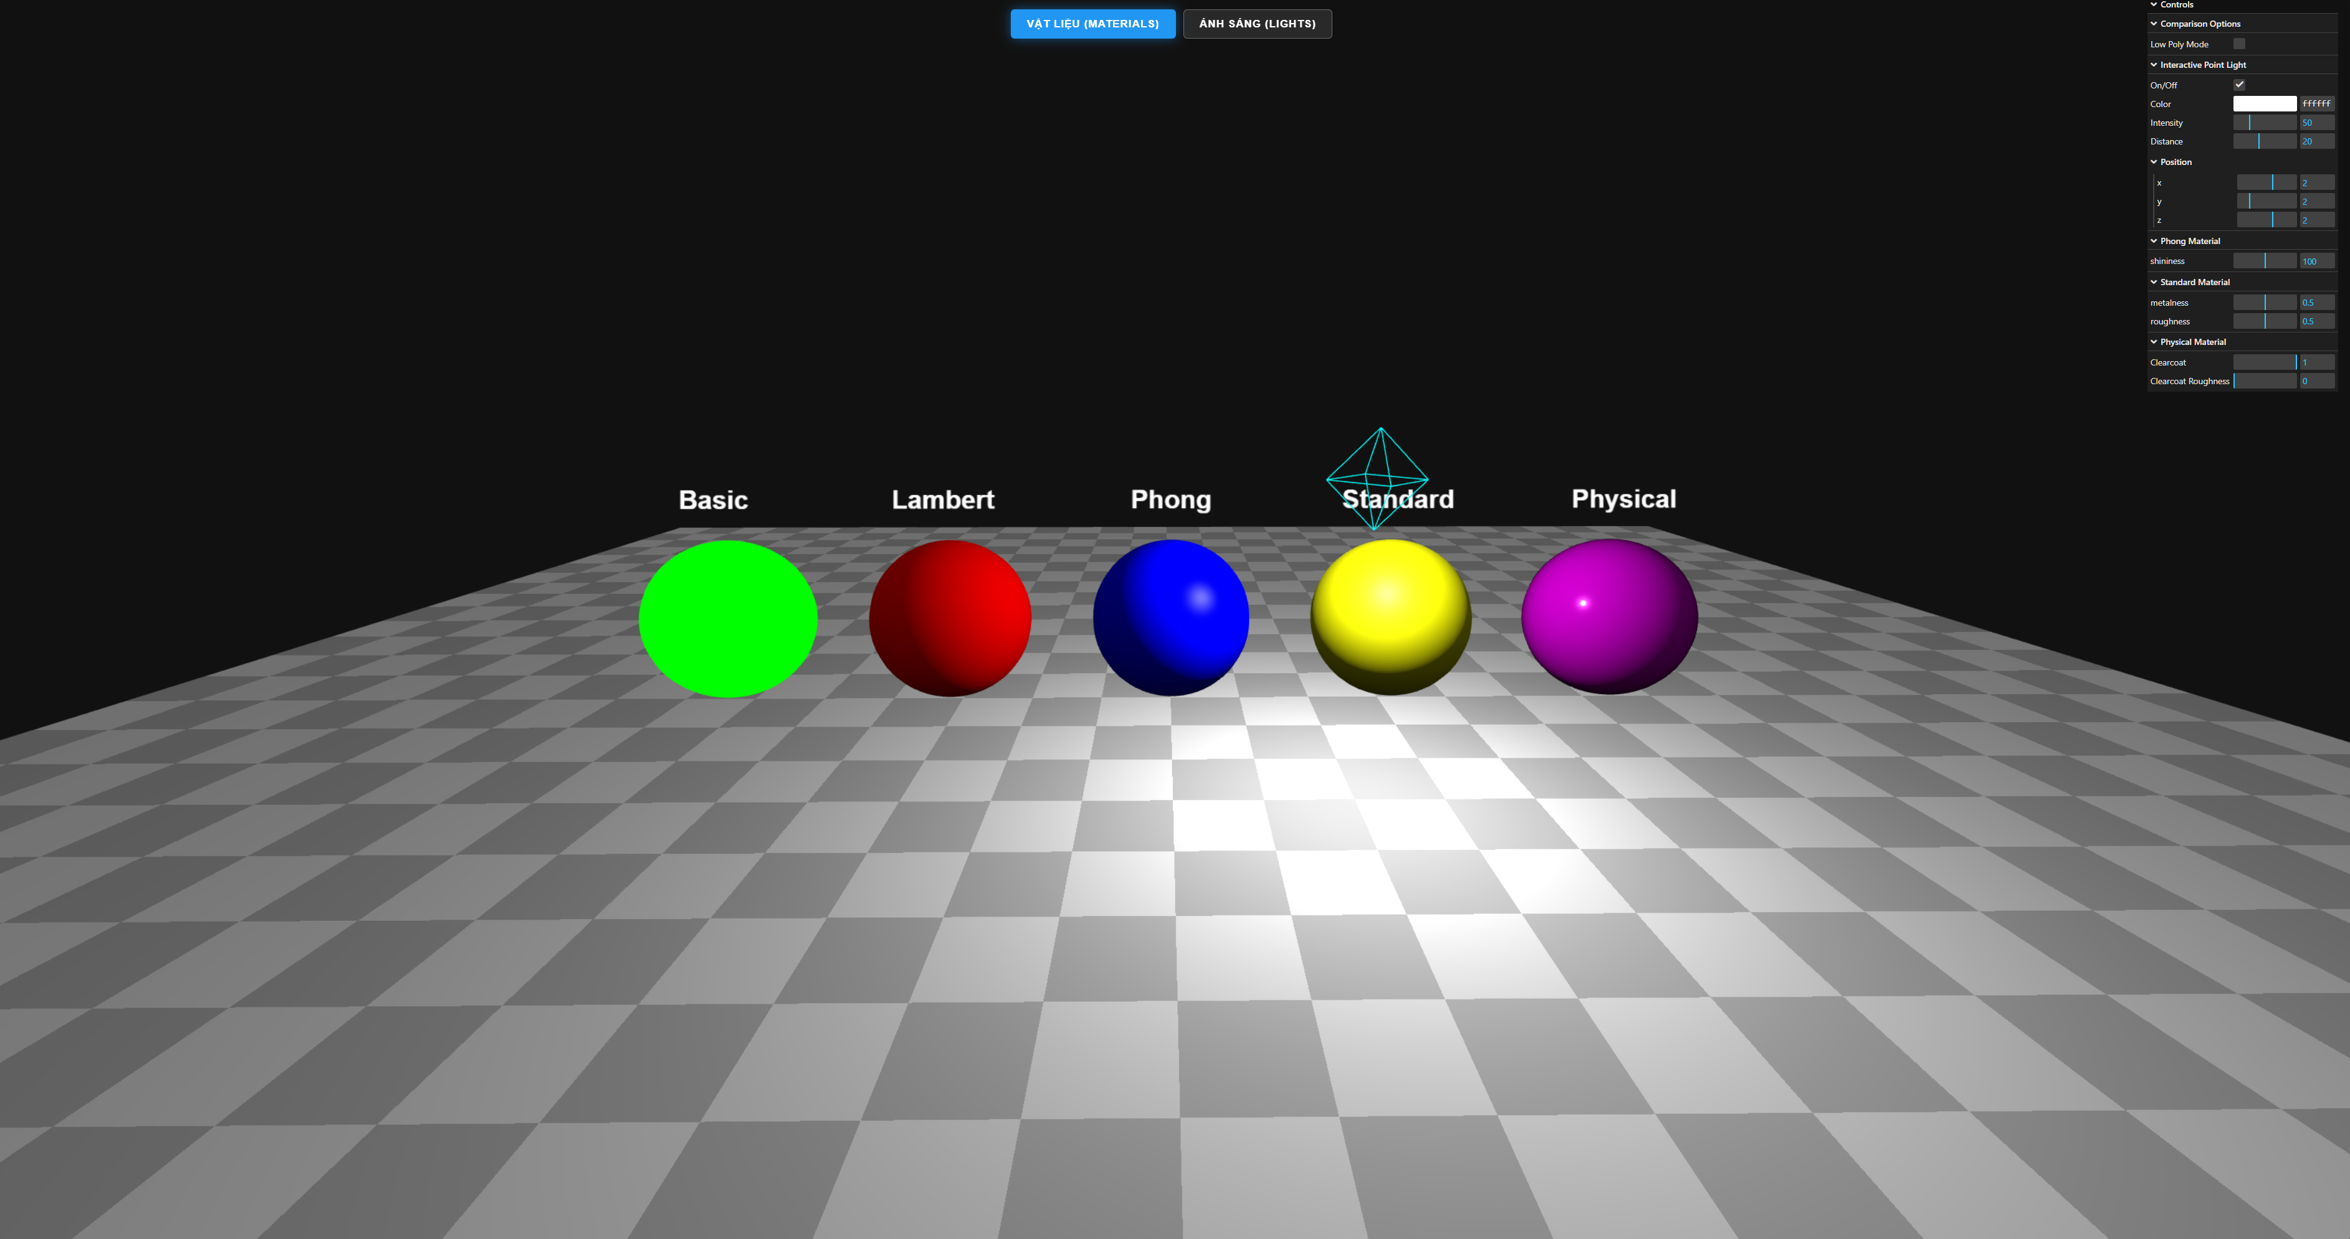
Installation
Open VSCode and create a new folder
Download the source code for Lecture 2 from the UET Portal
Open a terminal and type the following command:
npm install lil-gui
Run the source code. You should see a webpage with two tabs:
Materials
Lights

Slide 5
Materials

Slide 6
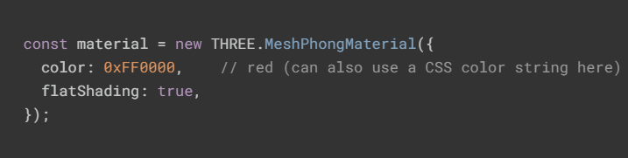
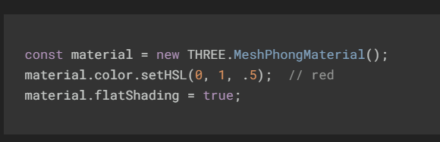
How to set material properties
Materials define how object will appear in the scene.
There are 2 ways to set most material properties.
At creation time: Best for static or default values that won’t change.
After creation time: Ideal for dynamic updates (e.g., animations, runtime conditions).
Notes:
Aspect At Creation Time After Creation
Code clarity
1) Properties are grouped in one place, making materials easier to read and maintain.
2) Can look scattered if many updates are applied later.
Performance
1) Slightly more efficient since properties are set once during instantiation.
2) May trigger re-renders or require material.needsUpdate = true for some changes.
Flexibility
1) Best for static or default values that won’t change.
2) Ideal for dynamic updates (e.g., animations, user interactions).
Maintainability
1) Easier to understand the material’s initial state.
2) Useful when properties depend on runtime conditions or external data.
✅ Pros of Setting at Creation
Cleaner initialization: All properties are defined in one object, reducing clutter.
Predictable defaults: Ensures the material starts in a known state.
Slightly faster setup: Avoids multiple property assignments after instantiation.
Good for static scenes: Works well when materials won’t change during runtime.
Pros of Setting After Creation
Dynamic updates: Allows changes based on user input, animations, or scene events.
Fine-grained control: You can adjust only specific properties without redefining the whole material.
Supports runtime logic: Useful when values depend on calculations or external data sources.
Experimentation: Easier to tweak properties interactively during development
Risks & Trade-offs
Performance overhead: Frequent updates may require material.needsUpdate = true, which can impact rendering speed.
Code readability: Scattered property changes can make debugging harder.
Unexpected states: If updates are conditional, materials may behave inconsistently unless carefully managed.
Recommendation
Use creation-time settings for default, static properties (e.g., base color, shading mode).
Use after-creation updates for dynamic behaviors (e.g., hover effects, animations, real-time lighting changes).
A hybrid approach is common: initialize with sensible defaults, then adjust selectively at runtime.

Slide 7
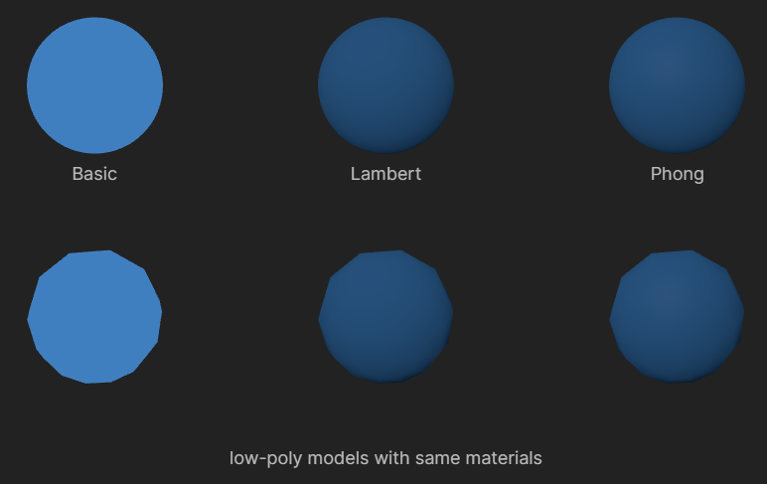
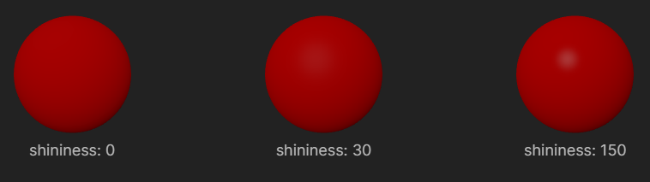
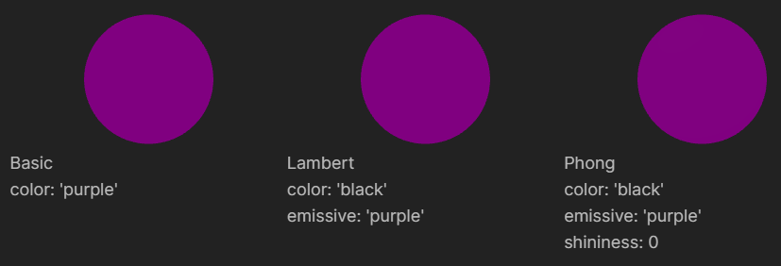
Commonly used types of material
There are 3 commonly used non-PBR materials: Basic, Lambert, and Phong
Basic Material is not affected by lights
Lambert Material computes lighting only at the vertices
Phong Material computes lighting at every pixel and support specular highlights.
Notes:
PBR: Physically based rendering materials (có simulate lại cách ánh sáng tương tác với vật thể theo vật lý)
Instead of using simple color and shading models, PBR materials use parameters like metalness, roughness, and reflectivity to mimic real-world materials more realistically under different lighting conditions.
Specular Highlight là gì? Specular Highlight là điểm sáng nổi bật trên bề mặt bóng khi được chiếu sáng, thể hiện sự phản xạ trực tiếp của nguồn sáng trên vật thể. Nó tạo ra hiệu ứng phản chiếu giống như gương, giúp người nhìn nhận biết hình dạng vật thể và vị trí của nguồn sáng trong cảnh 3D.
The shininess setting of the MeshPhongMaterial determines the shininess of the specular highlight. It defaults to 30.
Emissive property trong Three.js là gì? Thuộc tính màu sắc mà vật liệu phát ra như một nguồn sáng riêng, tạo hiệu ứng tự phát sáng trên bề mặt vật thể. Khác với các màu sắc phụ thuộc vào ánh sáng bên ngoài, màu emissive luôn hiển thị như một ánh sáng phát ra từ chính vật liệu đó, giúp mô phỏng các hiệu ứng như đèn neon, màn hình phát sáng, hoặc các bề mặt phát quang. Thuộc tính này không làm vật thể chiếu sáng lên các vật thể khác mà chỉ làm vật liệu đó trông như đang phát sáng.
Note that setting the emissive property to a color on either a MeshLambertMaterial or a MeshPhongMaterial and setting the color to black (and shininess to 0 for phong) ends up looking just like the MeshBasicMaterial.
Why have all 3 when MeshPhongMaterial can do the same things as MeshBasicMaterial and MeshLambertMaterial? The reason is the more sophisticated material takes more GPU power to draw. On a slower GPU like say a mobile phone you might want to reduce the GPU power needed to draw your scene by using one of the less complex materials. It also follows that if you don't need the extra features then use the simplest material. If you don't need the lighting and the specular highlight then use the MeshBasicMaterial.

Slide 8
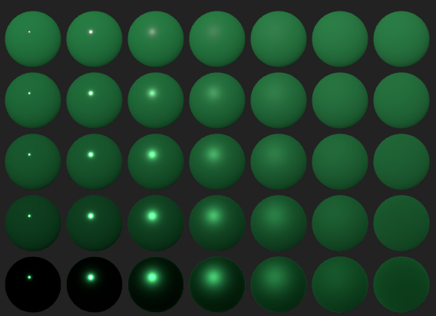
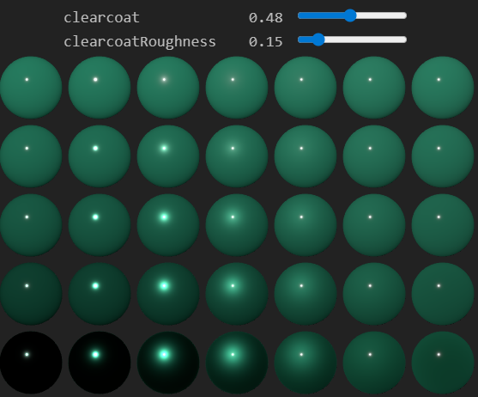
Commonly used types of material
There are 2 commonly used PBR materials: Standard, Physical
Standard Material has 2 settings roughness and metalness
Physical Material is same as Standard Material, but it adds a clearcoat gloss layer.
Notes:
Standard Material:
At a basic level roughness is the opposite of shininess. Something that has a high roughness, like a baseball doesn't have hard reflections whereas something that's not rough, like a billiard ball, is very shiny. Roughness goes from 0 to 1.
The other setting, metalness, says how metal the material is. Metals behave differently than non-metals. 0 for non-metal and 1 for metal.
Here's a quick sample of MeshStandardMaterial with roughness from 0 to 1 across and metalness from 0 to 1 down.
Physical Material:
The MeshPhysicalMaterial is same as the MeshStandardMaterial but it adds a clearcoat parameter that goes from 0 to 1 for how much to apply a clearcoat gloss layer and a clearCoatRoughness parameter that specifies how rough the gloss layer is.

Slide 9
Commonly used types of material
The various standard materials progress from fastest to slowest
Basic ➡ Lambert ➡ Phong ➡ Standard ➡ Physical
The slower materials can make more realistic looking scenes, but you might need to design your code to use the faster materials on low powered machines.

Slide 10
Other types of material
There are 3 materials that have special uses
Shadow Material is used to get the data created from shadows.
Normal Material will show the normals of geometry. Normals are the direction a particular triangle or pixel faces.
Shader Material is for making custom materials using the three.js shader system.
Notes:
Shader system trong Three.js là các chương trình nhỏ chạy trên GPU, kiểm soát cách các điểm ảnh và đỉnh được hiển thị, giúp định nghĩa ánh sáng, màu sắc và hiệu ứng vật liệu ở mức thấp. Three.js cung cấp shader tích hợp cho các vật liệu chuẩn, đồng thời cho phép bạn tạo shader tùy chỉnh bằng ShaderMaterial để tạo hiệu ứng nâng cao.

Slide 11
Lights

Slide 12
Commonly used types of lights
There are 5 commonly used types of light
Ambient Light:
Has no direction, lighting is 100% even
The AmbientLight effectively just multiplies the material's color by the light's color times the intensity.
Hemisphere Light:
A HemisphereLight takes a sky color and a ground color and just multiplies the material's color between those 2 colors.
Directional Light:
Often used to represent the sun.
We had to add the light and the light.target to the scene. A Directional Light will shine in the direction of its target.
Point Light:
A PointLight is a light that sits at a point and shoots light in all directions from that point.
Spot Light:
Spotlights are effectively a point light with a cone attached where the light only shines inside the cone.
Notes:
Hemisphere Light:
The sky color if the surface of the object is pointing up and the ground color if the surface of the object is pointing down.
Notice again there is almost no definition, everything looks kind of flat. The HemisphereLight used in combination with another light can help give a nice kind of influence of the color of the sky and ground.
Point Light:
A PointLight has the added property of distance. If the distance is 0 then the PointLight shines to infinity. If the distance is greater than 0 then the light shines its full intensity at the light and fades to no influence at distance units away from the light.
Notice when distance is > 0 how the light fades out.
Spot Light:
There's actually 2 cones. An outer cone and an inner cone. Between the inner cone and the outer cone the light fades from full intensity to zero.
To use a SpotLight we need a target just like the directional light. The light's cone will open toward the target.
The inner cone is defined by setting the penumbra property as a percentage from the outer cone. In other words when penumbra is 0 then the inner cone is the same size (0 = no difference) from the outer cone. When the penumbra is 1 then the light fades starting in the center of the cone to the outer cone. When penumbra is .5 then the light fades starting from 50% between the center of the outer cone.
Notice with the default penumbra of 0 the spotlight has a very sharp edge whereas as you adjust the penumbra toward 1 the edge blurs.

